Slide 1
MTH205 PRESENTATION
NUMERICAL WEATHER PREDICTION

Slide 2
OUTLINE
Introduction
Historical Background
Models and forecast process
Concept of parameterization
NWP Equations
Model types
Model Errors
Model precipitation
Convective parameterization
Model comparison

Slide 3
INTRODUCTION
NWP is a highly specialized field
Continuously evolving due to:
development of new modeling techniques
new parameterization schemes
availability of faster computing resources
Operational forecast centers utilize complex prediction models that require state of the art computer resources for their solution
Research models range from simple to the extremely complex depending on the research application

Slide 4
HISTORICAL BACKGROUND
The first attempt to predict the weather numerically was by the British scientist L.F. Richardson
His book Weather Prediction by Numerical Process was published in 1922
Richardson showed how the differential equations governing atmospheric motions could be written approximately as a set of algebraic difference equations for values of the tendencies of various field variables at a finite number of points in space
Given the observed values of these field variables at these grid points the tendencies could be calculated numerically by solving the algebraic difference equations
The new values of the field variables could then be used to recompute the tendencies which in turn could be used to extrapolate further further ahead in time, etc

Slide 5
By extrapolating the computed tendencies ahead a small increment in time, an estimate of the fields at a short time in the future could be obtained
Even for a short-range forecast over a small area of the earth this procedure requires an enormous number of arithmetic calculations
Richardson did not foresee the development of high speed computers (how could he?)
Estimated that a work force of 64 000 people would be required simply to keep up with the weather on a global basis
Richardson tried a “forecast” by hand – unfortunately the results were poor due to poor initial data and the inclusion of fast waves like sound and gravity waves
Numerical weather prediction was not attempted again until after WW2 – interest grew due to improved meteorological
observational network and the development of digital computers

Slide 6
J. G. Charney showed in 1948 how the dynamical equations could be simplified using the geostrophic and hydrostatic approximations so that sound and gravity waves were filtered out (essentially the quasi- geostrophic model)
A special case of his model – the equivalent barotropic model was used in 1950 to make the first numerical forecast
The model provided forecasts of the geopotential near 500 mb – thus it did not predict weather in the usual sense – however it could be used to assist forecasters in predicting local weather as a result of large-scale circulations
With the development of more powerful computers and better modeling techniques numerical weather prediction has returned to models that are quite similar to Richardson’s model and are more accurate
Current operational models are generally hydrostatic

Slide 7
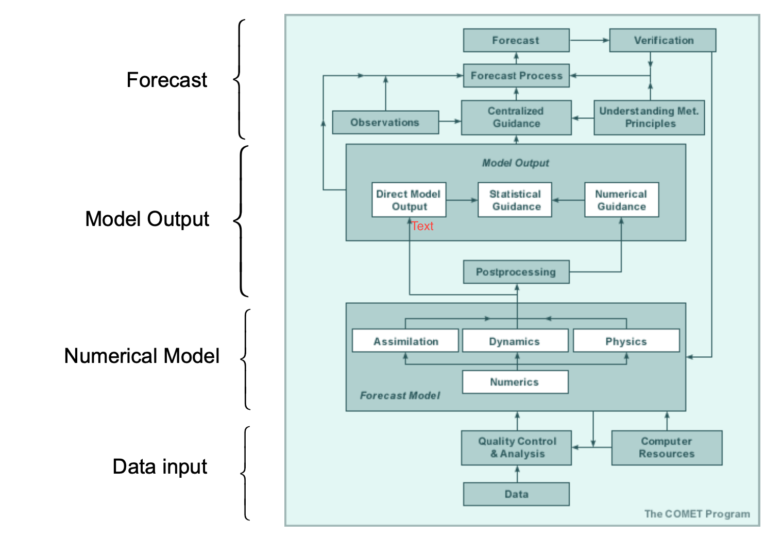
MODELS AND THE FORECAST PROCESS

Slide 8
PARAMETERIZATION
Parameterization is how we include the effects of physical processes IMPLICITLY (indirectly) when we cannot include the processes themselves EXPLICITLY (directly)
Parameterization can be thought of as modeling the effects of a process rather than modeling the process itself
The are many complex processes in the atmosphere that need to be parameterized in NWP models eg radiative processes, cloud processes, turbulence
The number and type of parameterizations that are used depend on the model resolution and what the model is to be used for
The processes shown below are often parameterized because:
they cannot be explicitly predicted in full detail by model forecast equations in spite of the model resolution
their effects are important to the simulation

Slide 9
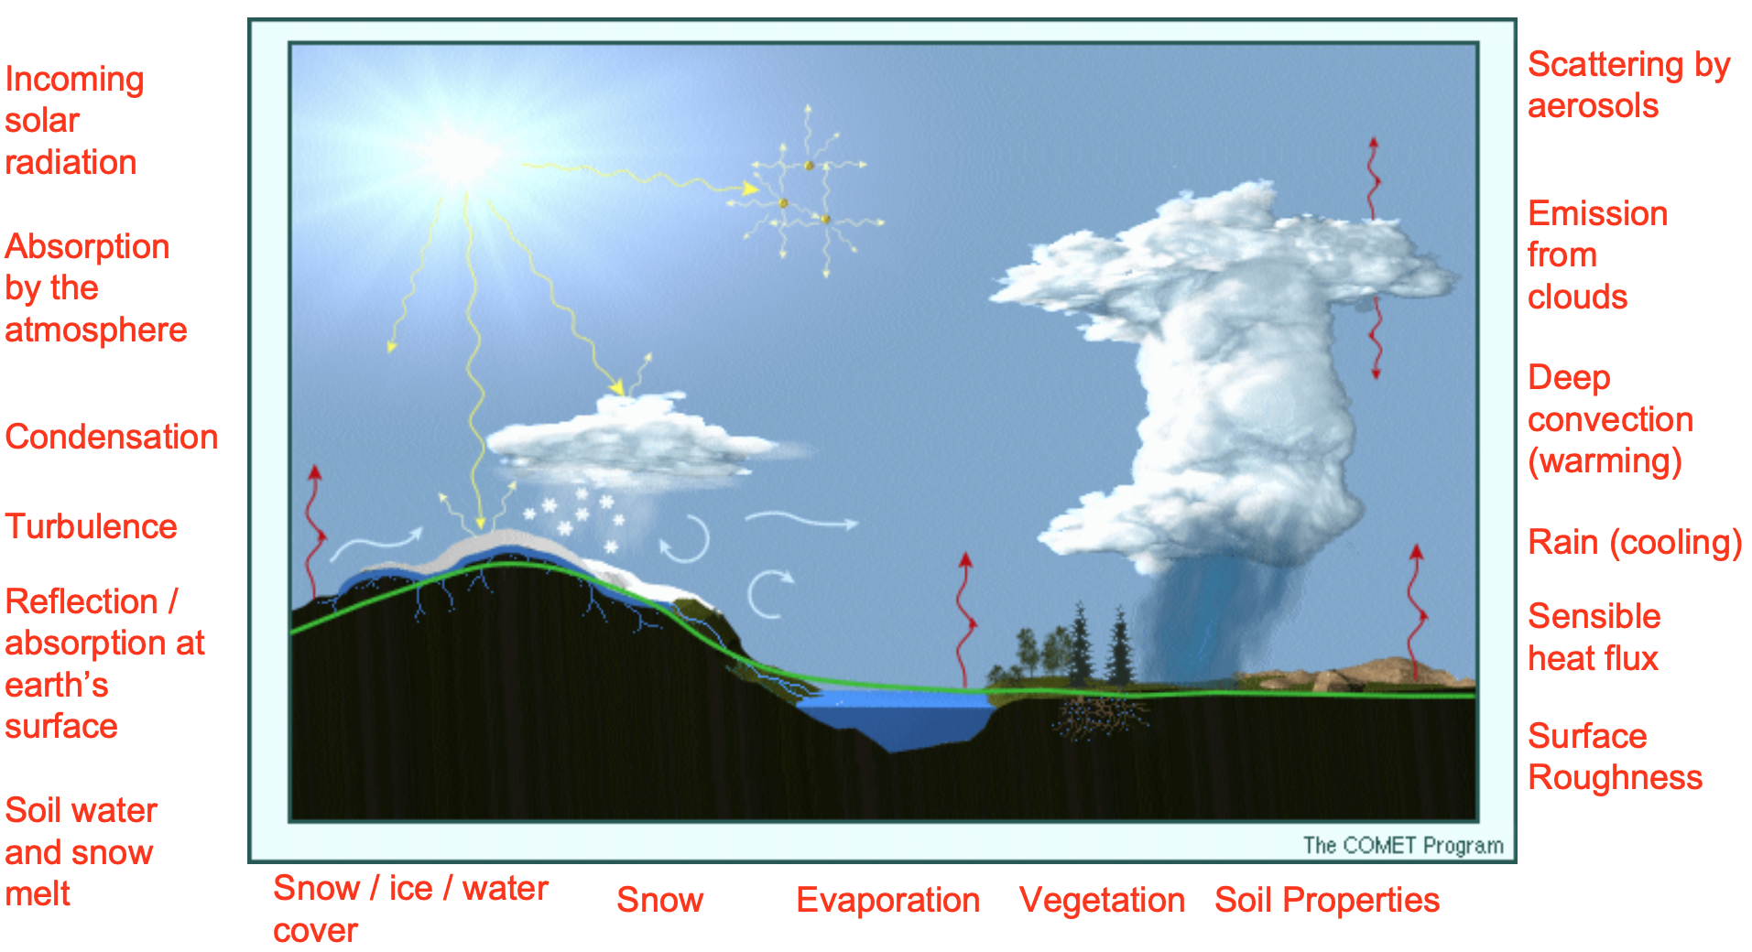

Slide 10
Parameterization is necessary for several reasons:
Computers are not yet powerful enough to treat many physical processes explicitly because they are either too small or complex to be resolved
Many other physical processes cannot be explicitly modeled because they are not sufficiently understood to be represented in equation format or there are no appropriate data

Slide 11
NWP EQUATIONS
The PRIMITIVE EQUATIONS are used as the forecast equations in NWP models.
Vilhelm Bjerknes first recognized that numerical weather prediction was possible in principle in 1904.
He proposed that weather prediction could be seen as an initial value problem in mathematics
Since equations govern how meteorological variables change with time, if we know the initial condition of the atmosphere, we can solve the equations to obtain new values of those variables at a later time (i.e., make a forecast).

Slide 12
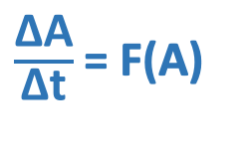
To represent an NWP model in its simplest form, we can write
where
∆A gives the change in a forecast variable at a particular point in space
∆t gives the change in time (how far into the future we are forecasting)
F(A) represents terms that can cause changes in the value of A
This equation means that the change in forecast variable A during the time period t is equal to the cumulative effects of all processes that force A to change.
Future values of meteorological variables are solved for by finding their initial values and then adding the physical forcing that acts on the variables over the time period of the forecast. This is stated as
$\frac{\text{∆}\text{A}}{\text{∆}\text{t}}$ = F(A)

Slide 13
A^{forecast} = A^{initial} + F(A)∆t
where F(A) stands for the combination of all of the kinds
of forcing that can occur
The process is then repeated for the duration of the simulation
This stepwise process represents the configuration of the prediction equations used in NWP.

Slide 14
PROBLEMS ASSOCIATED WITH NWP EQUATIONS
The way in which primitive equations are derived from their complete theoretical form and converted to computer codes can contribute to errors
The model forecast equations are simplified versions of the actual physical laws governing atmospheric processes, especially cloud processes, land- atmosphere exchanges, and radiation. The physical and dynamic approximations in these equations limit the phenomena that can be predicted.
Due to their complexity, the primitive equations must be solved numerically using algebraic approximations, rather than calculating complete analytic solutions. These numerical approximations introduce error even when the forecast equations completely describe the phenomenon of interest and even if the initial state were perfectly represented.
Computer translations of the model forecast equations cannot contain all details at all resolutions. Therefore, some information about atmospheric fields will be missing or misrepresented in the model even if perfect observations were available and the initial state of the atmosphere were known exactly.
Grid point and spectral methods are techniques for representing information about atmospheric variables in the model and solving the set of forecast equations. Each technique introduces different types of errors.

Slide 15
MODEL TYPES
The type of model being used (grid point or spectral) influences:
How the model equations are solved
How the data are represented
The type of weather features that can be resolved
We will look at 4 different types of models:
Grid point models
Spectral models
Hydrostatic models
Non-hydrostatic models

Slide 16
GRID POINT MODELS
Data Representation
In the real atmosphere, wind, pressure, temperature, and moisture vary from location to location in a smooth, continuous way
Grid point models, however, perform their calculations on a fixed array of spatially disconnected grid points. The values at the grid points actually represent an area average over a grid box.
The continuous temperature field shown in the next graphic, therefore, must be represented at each grid point as shown by the black numbers in the right panel of the previous graphic. The temperature value at the grid point represents the grid box volume average.

Slide 17
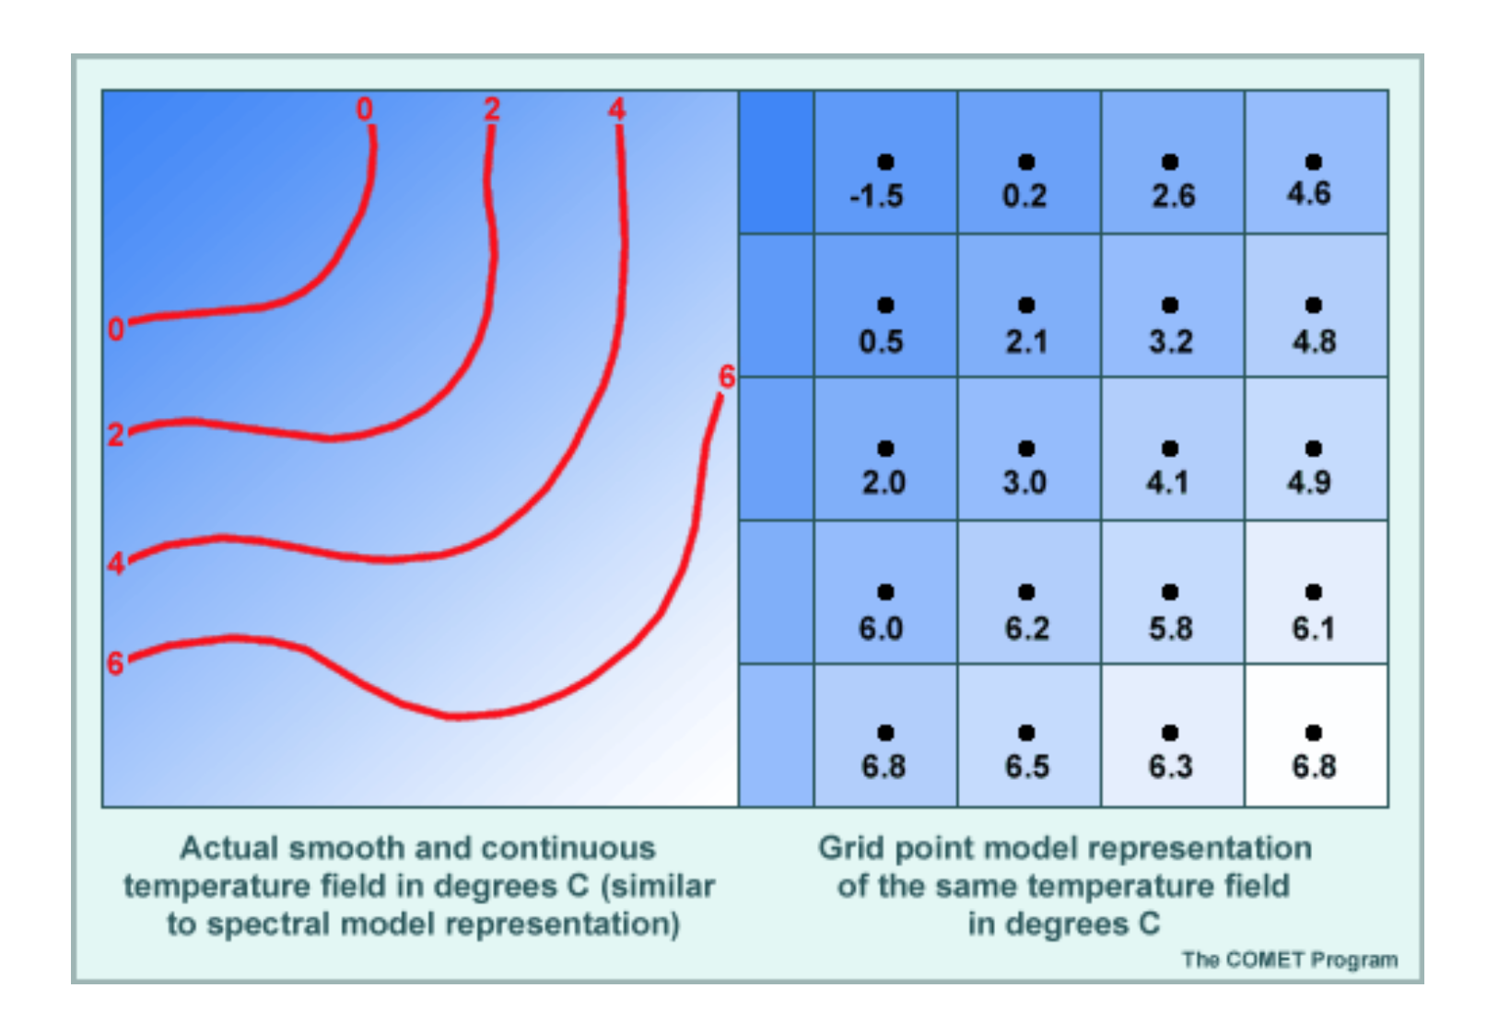

Slide 18
Grid point models actually represent the atmosphere in three-dimensional grid cubes, such as the one shown below.
The temperature, pressure, and moisture (T, p, and q), shown in the center of the cube, represent the average conditions throughout the cube.
The east-west winds (u) and the north-south winds (v), located at the sides of the cube, represent the average of the wind components between the center of this cube and the center of the adjacent cubes.
Similarly, the vertical motion (w) is represented on the upper and lower faces of the cube.
This arrangement of variables within and around the grid cube (called a staggered grid) has advantages when calculating derivatives. It is also physically intuitive; average thermodynamic properties inside the grid cube are represented at the center, while the winds on the faces are associated with fluxes into and out of the cube.

Slide 19
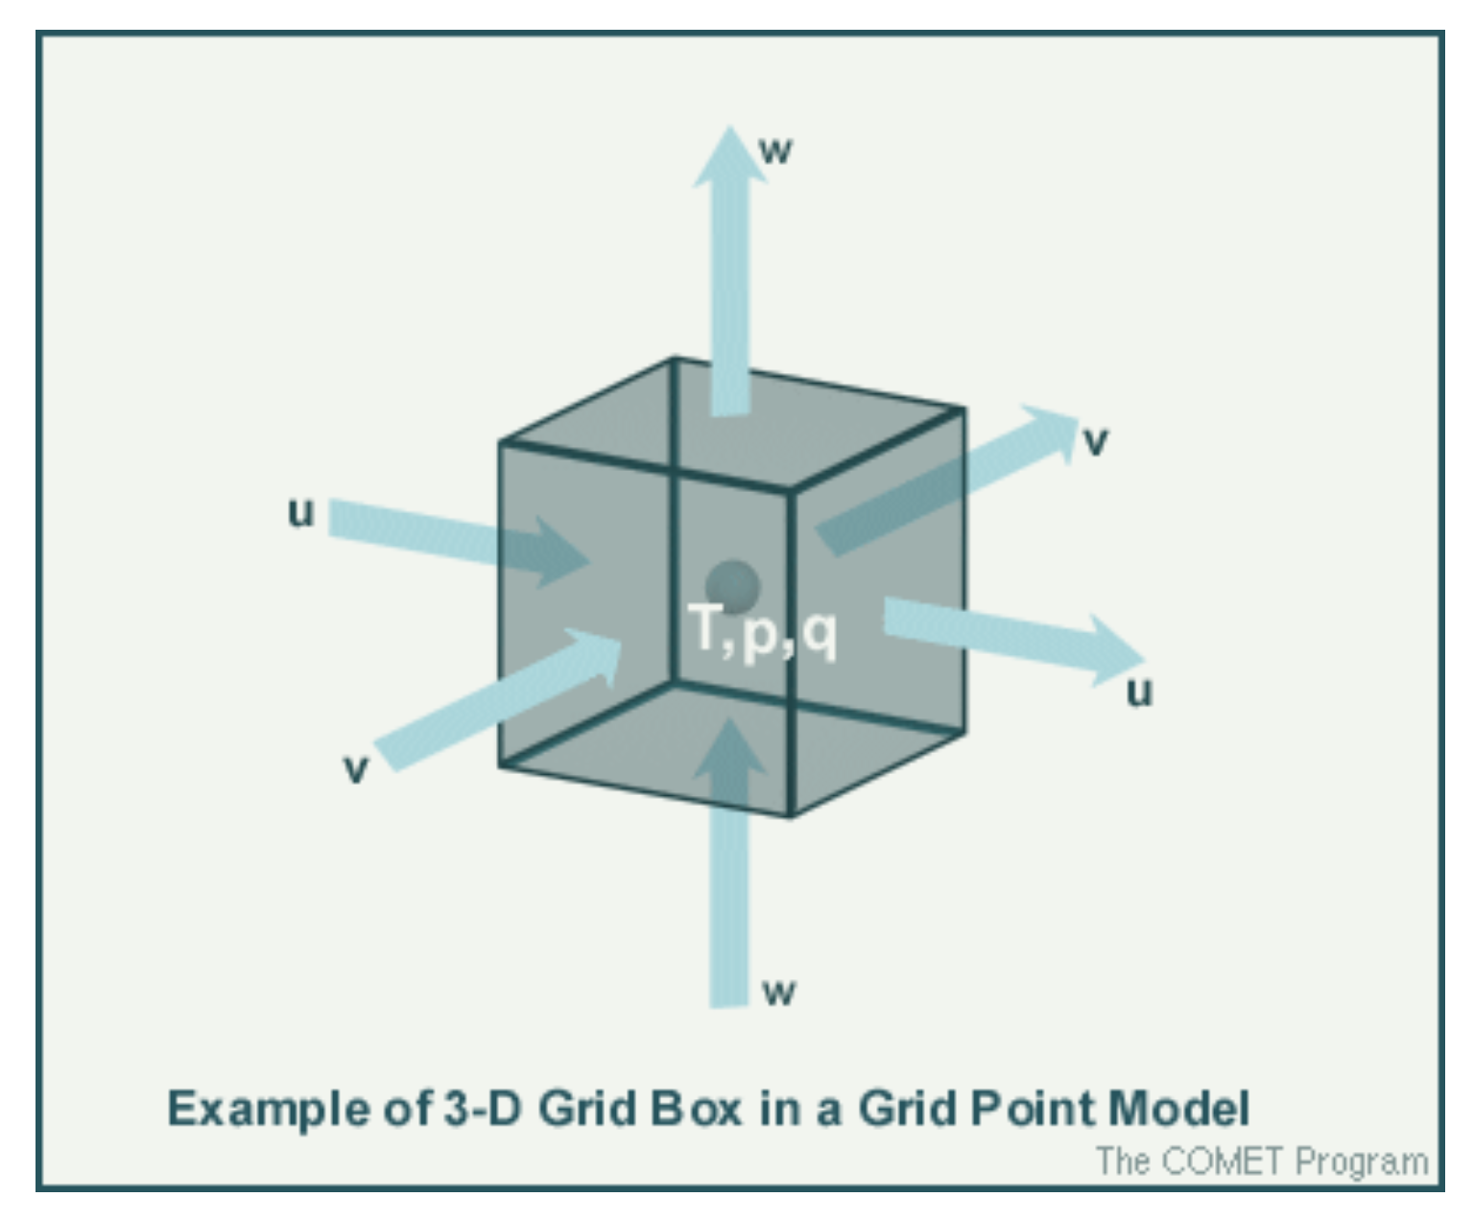

Slide 20
Truncation Errors
Grid point models must use finite difference techniques to solve the forecast equations.
In the real atmosphere, advection often occurs at very small scales.
The greater the distance between grid points, the less likely the model will be able to detect small-scale variations in the temperature and moisture fields.
The lack of resolution introduces errors into the solution of the finite difference equation.
Deficiencies in the ability of the finite difference approximations to calculate gradients and higher order derivatives exactly are called TRUNCATION ERRORS.

Slide 21
Characteristics
Data are represented on a fixed set of grid points
Resolution is a function of the grid point spacing
All calculations are performed at grid points
Finite difference approximations are used for solving the derivatives of the model's equations
Truncation error is introduced through finite difference approximations of the primitive equations
The degree of truncation error is a function of grid spacing and time-step interval.

Slide 22
Advantages
Can provide high horizontal resolution for regional and mesoscale applications
Do not need to transform physics calculations to and from gridded space
As the physics in operational models becomes more complex, grid point models are becoming computationally competitive with spectral models
Non-hydrostatic versions can explicitly forecast details of convection, given sufficient resolution and detail in the initial conditions

Slide 23
Disadvantages
Finite difference approximations of model equations introduce a significant amount of truncation error
Small-scale noise accumulates when equations are integrated for long periods
The magnitude of computational errors is generally more than in spectral models of comparable resolution
Boundary condition errors can propagate into regional models and affect forecast skill
Non-hydrostatic versions cover only very small domains and short forecast periods

Slide 24
SPECTRAL MODELS
Data Representation
Spectral models represent the spatial variations of meteorological variables as a finite series of waves of differing wavelengths
Truncation Errors
What are the effects of truncation in a spectral model?
Recall that in a grid point model, truncation error is associated with the finite difference approximations used to evaluate the derivatives of the model forecast equations.
One of the nice features of the spectral formulation is that most horizontal derivatives are calculated directly from the waves and are therefore extremely accurate.
This does not mean that spectral models have no truncation effects at all. The degree of truncation for a given spectral model is associated with the scale of the smallest wave represented by the model.

Slide 25
A grid point model tries to include all scales but does a poor job of handling waves only a few grid points across. A spectral model represents all of the waves that it resolves perfectly but includes no information on smaller- scale waves.
If the number of waves in the model is small (for example, T80), only larger features can be represented and smaller-scale features observed in the atmosphere will be entirely eliminated from the forecast model.
Therefore, spectral models with limited numbers of waves can quickly depart from reality in situations involving rapid growth of initially small-scale features.
Several types of wave orientation are possible in spectral models. Triangular (T, as in T170) configuration is the most common in operational models since it has roughly the same resolution in the zonal and meridional directions around the globe.

Slide 26
Characteristics
Data are represented by wave functions
Resolution is a function of the number of waves used in the model
Model resolution is limited by the maximum number of waves
The linear quantities of the equations of motion can be calculated without introducing computational error
Grids are used to perform non-linear and physical calculations
Transformations occur between spectral and grid point space
Equations can be integrated for large time steps and long periods of time
Originally designed for global domains

Slide 27
Advantages
The magnitude of computational errors in dynamics calculations is generally less than in grid point models of comparable resolution
Can calculate the linear quantities of the equations of motion exactly
At horizontal resolutions typically required for global models (late 1990s), require less computing resources than grid point models with equivalent horizontal resolution and physical processes
Disadvantages
Transformations between spectral and grid point physics calculations introduce errors in the model solution
Generally not designed for higher resolution regional and mesoscale applications
Computational savings decrease as the physical realism of the model increases

Slide 28
HYDROSTATIC MODELS
Most grid point models and all spectral models in the current operational NWP models are hydrostatic. This means that no vertical accelerations are calculated explicitly.
The hydrostatic assumption is valid for synoptic- and planetary-scale systems and for some mesoscale phenomena. An important exception is deep convection, where buoyancy becomes an important force.
Hydrostatic models account for the effects of convection using statistical parameterizations approximating the larger-scale changes in temperature and moisture
caused by non-hydrostatic processes.

Slide 29
Characteristics
Use the hydrostatic primitive equations, diagnosing vertical motion from predicted horizontal motions
Used for forecasting synoptic-scale phenomena, can forecast some mesoscale phenomena
Used in both spectral and grid point models (for instance, the AVN/MRF and Eta)

Slide 30
Disadvantages
Cannot predict vertical accelerations
Cannot predict details of small-scale processes associated with buoyancy
Advantages
Can run fast over limited-area domains, providing forecasts in time for operational use
The hydrostatic assumption is valid for many synoptic- and sub-synoptic-scale phenomena

Slide 31
NON-HYDROSTATIC MODELS
Currently, most non-hydrostatic models are grid point models. They are generally used in forecast or research problems requiring very high horizontal resolution (from tens of meters to a few kilometers) and cover relatively small domains.
Non-hydrostatic models can explicitly (directly) forecast the release of buoyancy in the atmosphere and its effects on the development of deep convection.
To do this, non-hydrostatic models must include an additional forecast equation that accounts for vertical accelerations and vertical motions directly, rather than determining the vertical motion diagnostically from horizontal divergence.

Slide 32
Characteristics
Use the non-hydrostatic primitive equations, directly forecasting vertical motion
Used for forecasting small-scale phenomena
Predict realistic-looking, detailed mesoscale structure and consistent impact on surrounding weather, resulting in either superior local forecasts or large errors

Slide 33
Disadvantages
Take longer to run than hydrostatic models with the same resolution and domain size
Used for limited-area applications, so they require boundary conditions (BCs) from another model; if the BCs lack the structure and resolution characteristic of fields developing inside the model domain, they may exert great influence on the forecast
May predict realistic-looking phenomena, but the timing and placement may be unreliable
Advantages
Calculate vertical motion explicitly
Explicitly predict release of buoyancy
Account for cloud and precipitation processes and their contribution to vertical motions
Capable of predicting convection and mountain waves

Slide 34
MODEL ERROR
Three categories of model errors:
Errors in initial conditions
Errors in the model
Intrinsic predictability limitations

Slide 35
Errors in Initial Condition
Inadequate spatial density
Inadequate temporal frequency
Instrument error/data transmission problems
Representativeness errors
Quality control errors
Objective analysis errors (weighting and interpolation)
Data assimilation difficulties

Slide 36
Errors in Model
Incomplete formulation of equations of motion
Horizontal and vertical numerical approximation errors
Time interpolation errors
Boundary conditions (only vertical in global models)
Inadequate terrain representation
Large-scale precipitation processes not well estimated
Shortcomings of convective parameterizations
Estimations of clouds and cloud radiative processes
Heat, moisture, and momentum flux approximations (both between ground and air, & BL and free atmosphere)

Slide 37
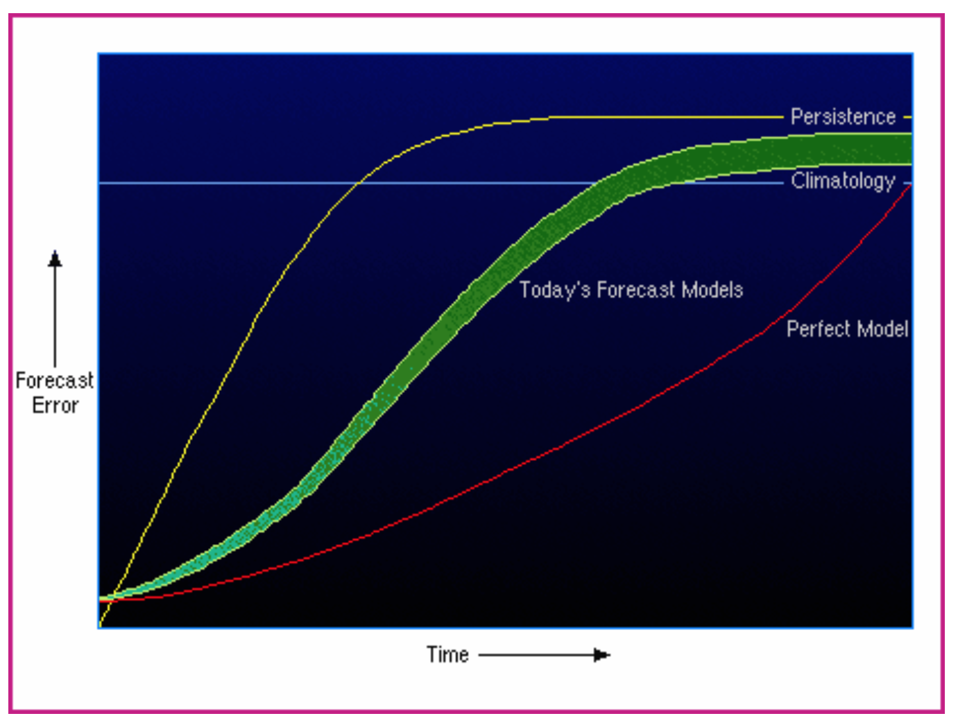
Intrinsic Predictability Limitations
Unmeasured scales of
motion (energy transfer between scales)
Error growth with time

